Slide 1
Rpart: Classification and Regression Trees

Slide 2
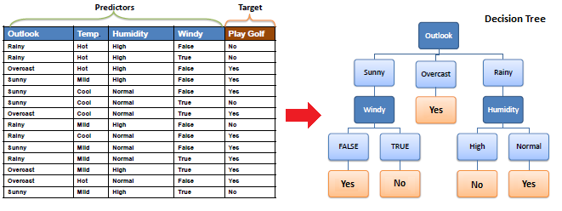
Decision Trees
Decision Trees are flow-chart like structures where internal nodes represent tests, branches represent outcomes of those tests and leaves represent class labels (decision taken after computing).

Slide 3
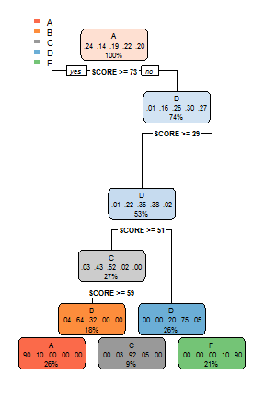
Example - Moody
Decision tree for moody based on only score.
Picture shows predicted grades for various scores.
“yes” condition on the left side, “no” on the right.

Slide 4
What is Rpart?
Rpart is a collection of routines which implement Classification and Regression Tree ideas.
Rpart builds classification or regression models based on variables in the data. The resulting model can be represented as a binary tree.

Slide 5
Syntax for building Regression Tree
rpart(formula, method=, data=)
formula: Here we mention the prediction column and other related columns (predictors) as
prediction ~ predictor1+predictor2+predictor3+….
Method: Describes type of tree (“class” for classification; “anova” for regression)
Data: Data frame
Have a look at http://data101.cs.rutgers.edu/laboratory/pages/rpart section of data101 site

Slide 6
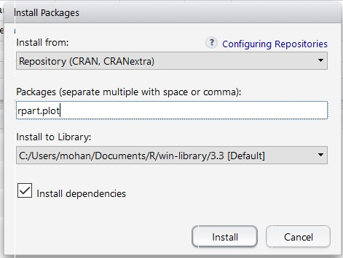
How to use rpart and rpart.plot
library(rpart) – to start using rpart R library
library(rpart.plot) – to plot trees generated by rpart.
Make sure rpart.plot is installed (Tools->Install Packages)
Have a look at http://data101.cs.rutgers.edu/laboratory/pages/rpart section of data101 site

Slide 7
Example with Moody Data Set
library(rpart)
library(rpart.plot)
m2018_train <- read.csv("~/Moody2018.csv",stringsAsFactors=FALSE)
tree <- rpart(GRADE ~ SCORE+DOZES_OFF+TEXTING_IN_CLASS+PARTICIPATION, data = m2018_train)
tree – This shows the prediction tree in text format
rpart.plot(tree)
Export this plot as a pdf and zoom in.
Have a look at http://data101.cs.rutgers.edu/laboratory/pages/rpart section of data101 site
Notes:
predict <- rpart(GRADE ~ . , data = M2017_train) “.” -> rest of the columns

Slide 8
Control Parameter in Rpart
rpart(formula, data=, method=,control=)
control is an optional parameter to control tree growth.
minsplit – min number of observations that must exist for a split to be attempted.
minbucket – minimum number of observations in any terminal node.
For example, control=rpart.control (minsplit=30)requires that the minimum number of observations in a node be 30 before attempting a split.
https://gormanalysis.com/decision-trees-in-r-using-rpart/ for more details
Notes:
http://www.statmethods.net/advstats/cart.html

Slide 9
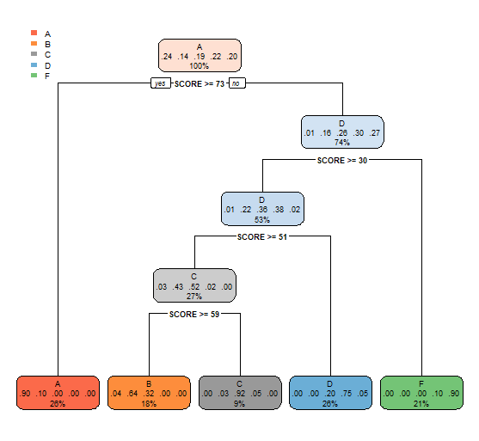
Example with Control Parameters
The plot generated previously is messy
tree <- rpart(GRADE ~ SCORE+DOZES_OFF+TEXTING_IN_CLASS+PARTICIPATION, control = rpart.control(minsplit = 200), data = m2018_train)
Minimum number of observations that must exist in a node for a split to be attempted is 200.
Have a look at http://data101.cs.rutgers.edu/laboratory/pages/rpart section of data101 site

Slide 10
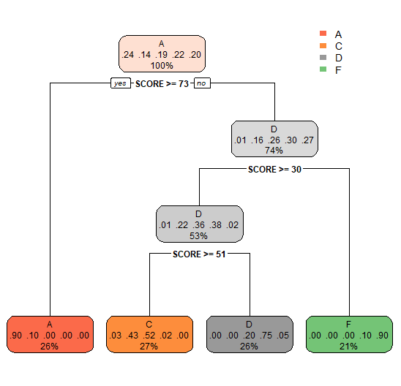
Example with Control Parameters
tree <- rpart(GRADE ~ SCORE+DOZES_OFF+TEXTING_IN_CLASS+PARTICIPATION,control = rpart.control(minbucket = 100), data = m2018_train)
Minimum number of observations in any terminal leaf node is 100.
Notice “B” is missing.
Have a look at http://data101.cs.rutgers.edu/laboratory/pages/rpart section of data101 site

Slide 11
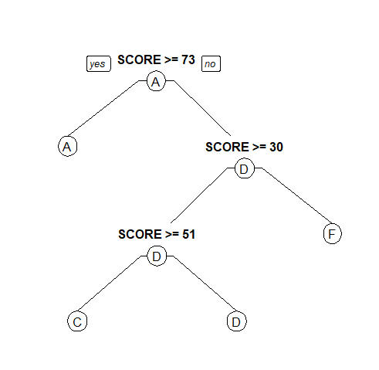
PRP (plot rpart model)
prp(tree, type = 1)
Change type values to change type of rplot
Have a look at http://data101.cs.rutgers.edu/laboratory/pages/rpart section of data101 site

Slide 12
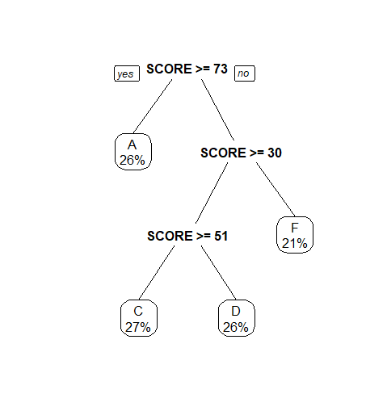
PRP (plot rpart model)
prp(tree, extra = 100)
Different way to show information of each decision using “extra”
Have a look at http://data101.cs.rutgers.edu/laboratory/pages/rpart section of data101 site

Slide 13
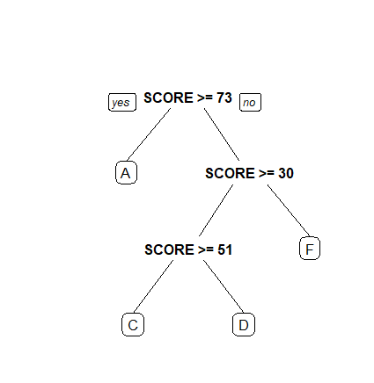
PRP (plot rpart model)
prp(tree, round = 1)
Change shape of leaves. round = 1 makes the leaves look round.
Have a look at http://data101.cs.rutgers.edu/laboratory/pages/rpart section of data101 site

Slide 14
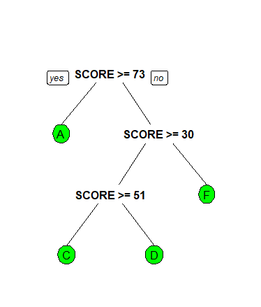
PRP (plot rpart model)
prp(tree, box.col = "green")
Change color of leaves
Have a look at http://data101.cs.rutgers.edu/laboratory/pages/rpart section of data101 site

Slide 15
Prediction
Rpredict<-predict(tree, newdata=<DATASET>,type="class" )
Once we have the rpart tree, we can use it to predict values on a dataset with above command. <DATASET> should be replaced by a data frame.
In moody example, this will print out the predicted grades column.

Slide 16

Cross Validation Function – Commands to install and run
Make sure while reading csv into data frame uncheck option stringsAsFactors
m2018_train <- read.csv("~/Moody2018.csv",stringsAsFactors=FALSE)
Code is available at github
install.packages("devtools")
devtools::install_github("devanshagr/CrossValidation")
CrossValidation::cross_validate(DataFrame, RpartOutput, No. of Cross Validations, Split Ratio of Training to Testing Data)
CrossValidation::cross_validate(m2018_train, tree, 2, 0.8)
Gives accuracy scores for 2 iterations.

Slide 17
THANK YOU

